Slide 1




A SENSOR-BASED DATA COLLECTION SYSTEM
A system that uses sensors to collect data from the environment or process.
creater
page 01
Bishal Pandey

Slide 2
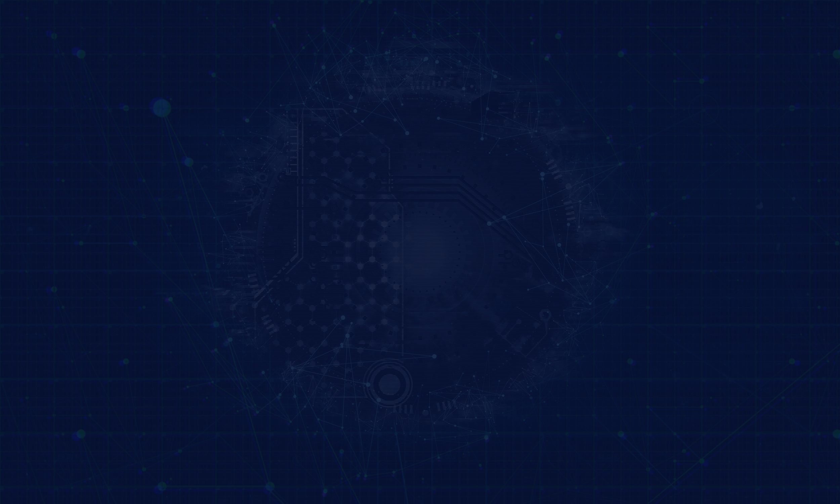

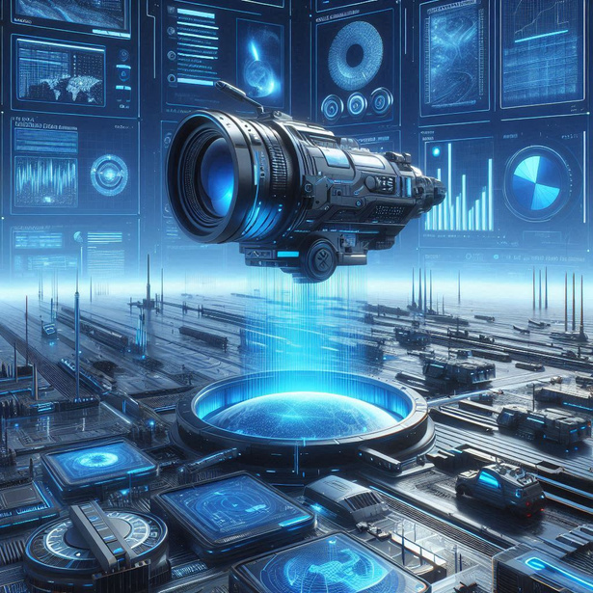
A system that gather data from the environment using sensors, which are devices that detect and measure specific physical properties. These sensors convert the data into digital signals and send it to a computer system or a central processing unit for analysis.
SENSOR-BASED DATA COLLECTION SYSTEM
Here are some example:
1. Smart city Traffic Management.
2. Environment Monitoring.
3. Healthcare Monitoring.
page 02

Slide 3
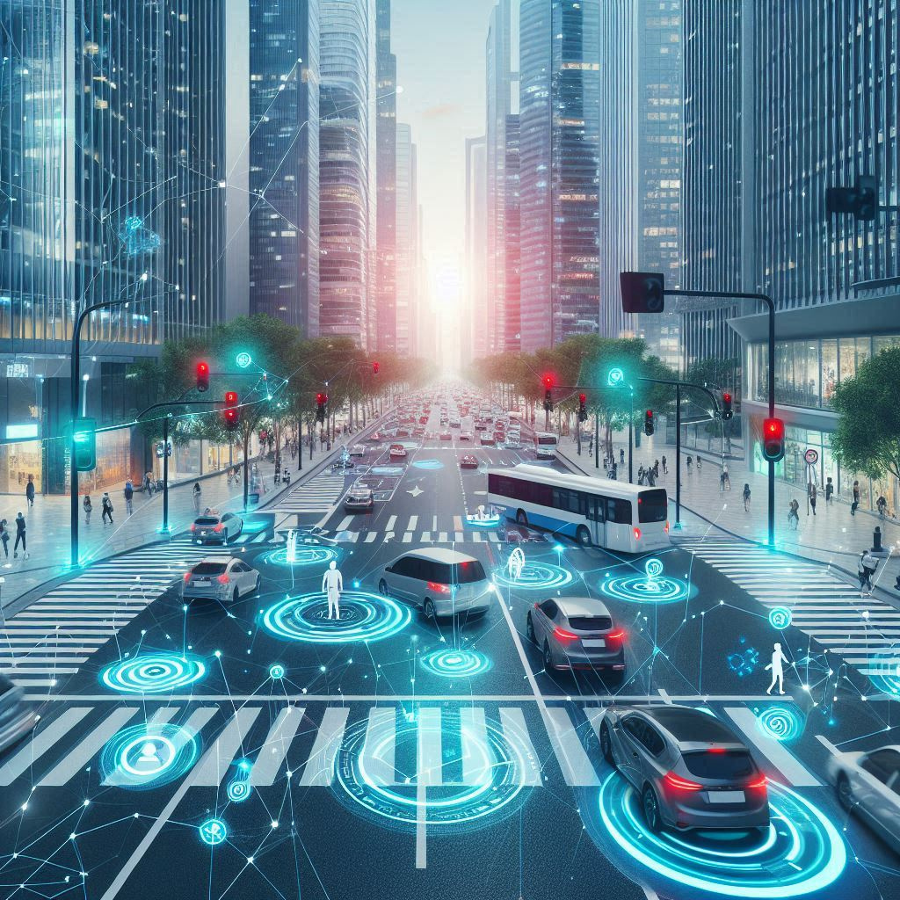
USE IN SMART TRAFFIC MANAGEMENT
A sensor-based traffic system uses sensors like cameras and vehicle detectors to monitor traffic and weather. Data is sent to a central system, which adjust traffic signals, reduces congestion, and improves safety. For example, Singapore use this to optimize traffic flow and provide real-time updates, making cities smarter and more efficient.
page 03

Slide 4

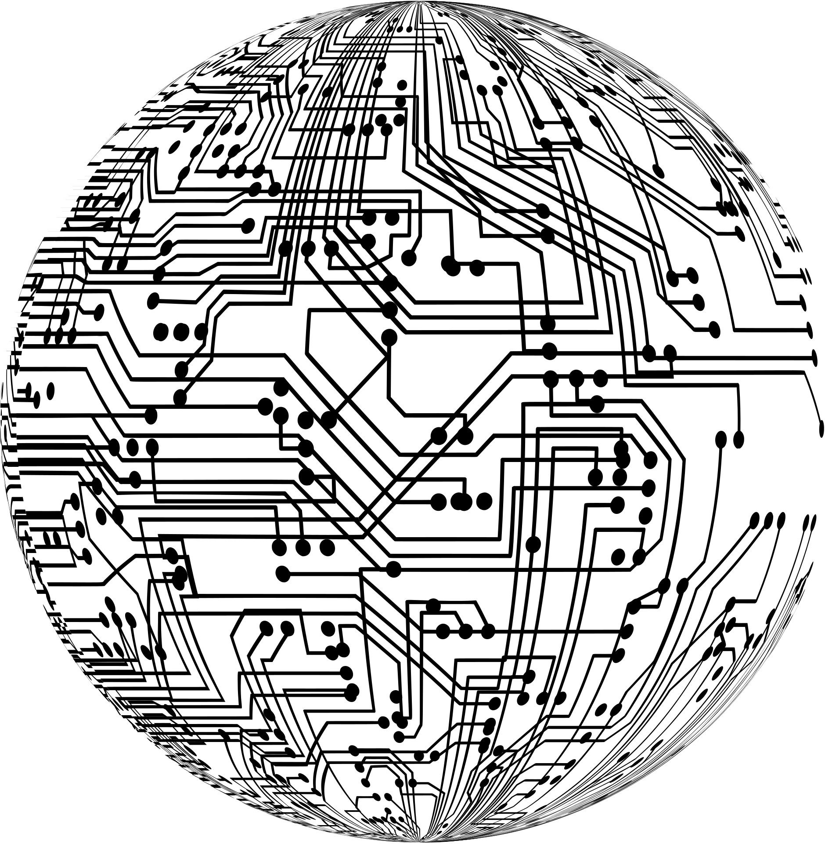

HOW DOES IT WORK
Sensors collect data.
Data is transmitted to a gateway or cloud.
Data is processed and analyzed.
Insights are displayed on a user interface (eg.:dashboard,mobile app).
Example:
Smart agriculture: Soil moisture => Cloud => Mobile app for farmers.
page 04

Slide 5



CHALLENGES
1.
2.
3.
Data security and privacy.
Integration of diverse sensors
Handling large volumes.
Different sensors use different communication protocols, making it hard to integrate them into a single system.
Sensors generate massive amounts of data, which can overwhelm storage and processing systems.
Sensitive data collected by sensors can be vulnerable to hacking or unauthorized access.
page 05

Slide 6
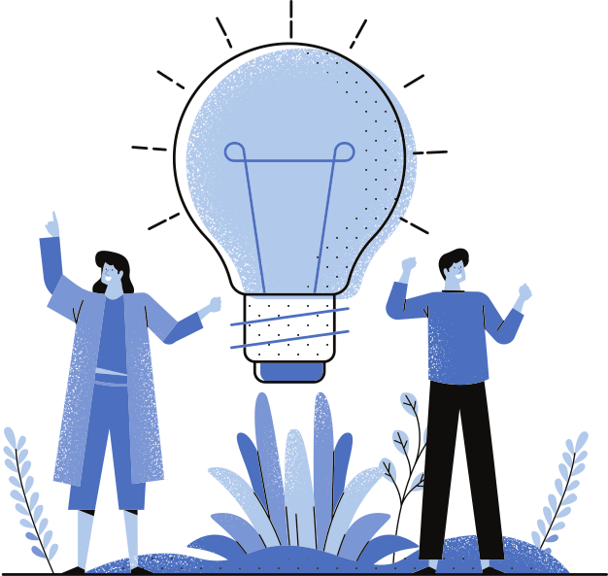

SOLUTIONS:
1.
Encryption
Use secure communication protocols to protect data.
2.
Standardized Protocols:
Adopt Common protocols like MQTT or CoAP for seamless integration.
3.
Edge Computing:
Process data locally (at the edge) t0 reduce latency and cloud dependency.
page 06

Slide 7

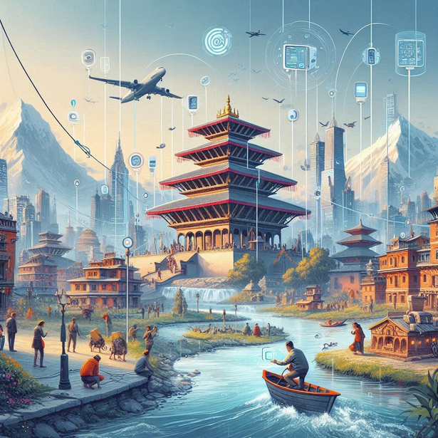
USE OF IT IN NEPAL
In Nepal like country it is primarily used in agriculture for soil moisture and weather monitoring, helping farmers optimize irrigation and improve crop yields in regions like Chitwan and Nawalparasi. They are also used in environment monitoring to track air quality in cities like kathmandu and detect floods in rivers such as koshi and Narayani. Additionally, these systems play a role in water management, monitoring water levels and quality in projects like the Melamchi water supply project.
page 07

Slide 8
CHALLENGE OF IT IN NEPAL
1.
2.
3.
4.
limited infrastructure and funding.
lack of technical experties
Geographic challenges
Policy and Regulation
page 08

Slide 9
1.
In Agriculture
Sensor can optimize irrigation, fertilization, and pest control, boosting crop yields and reducing resource waste.
FUTURE POTENTIAL IN NEPAL
2.
In Water Resource Management
Sensors can monitor water levels and quality, ensuring sustainable use in projects like Melamchi. Sensors can identify in pipelines, reducing water loss with proper data collection.
page 09

Slide 10
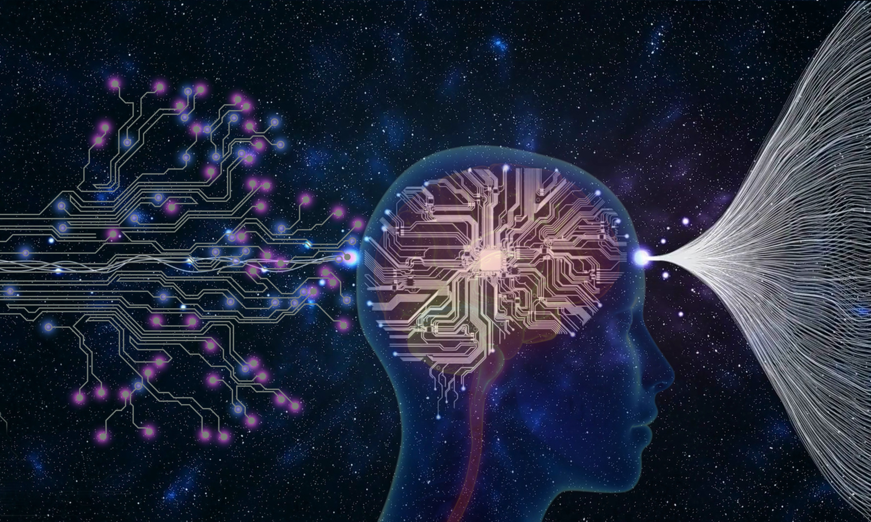
CONCLUSION
Sensor-based data collection system are transforming industries by enabling real-time monitoring and smarter decision-making. From agriculture to healthcare, they improve efficiency and reduce costs. Challenges like data security and integration are addressed through encryption, standardized protocols, and edge computing, With advancements in Al, 5G, and blockchain, these systems will continue to evolve, driving innovation and connectivity in a data-driven world.
page 06

Slide 11
THANK YOU!
As we look to the future, these technologies will play a crucial role in shaping a better world for generations to come.
page 07

